Slide 1
Elementary and Secondary School Emergency Relief (ESSER) Roundtable Series: ARP IDEA/ARP Homeless/Stakeholder Engagement
New Jersey Department of Education
Division of Educational Services
May 18, 2022

Slide 2
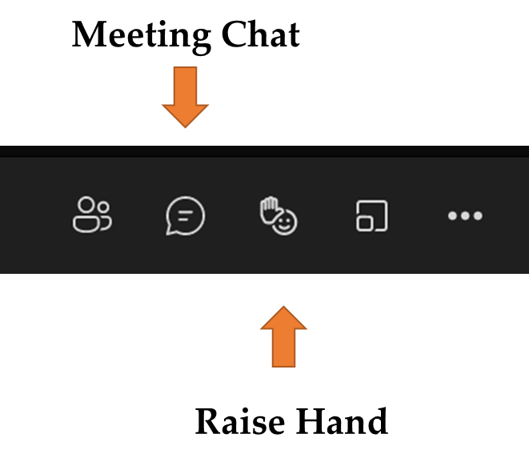
Using Microsoft Teams
Chat
We welcome your participation in discussions by asking questions and adding comments in the chat box.
Raise Hand
Please use the raise hand feature if you want to speak.
Mute/Unmute
Please remain muted whenever you are not speaking.

Slide 3
Agenda
Housekeeping Dr. A. Charles Wright, Executive Director/Deputy Assistant Commissioner Division of Educational Services
Welcome Ms. Kathy Ehling, Assistant Commissioner, Division of Educational Services
ARP IDEA Ms. Barbara Haake, Manager, Office of Fiscal and Data Services
ARP- Homeless Youth Funds Ms. Tamira Chapman, Office of Student Support Services
Stakeholders Ms. Andrea Sunderville, Coordinator, Office of Student Support SErvices
Homeless and Migrant Mr. Alan Ferraro, Region 3 Coordinator for Homeless and Migrant
Hamilton Township Public School

Slide 4
Welcome

Slide 5
ARP IDEA Ms. Barbara Haake, Manager Office of Fiscal and Data Services

Slide 6
ARP IDEA Supplemental Award
IDEA Part B Section 611: $74,068,356 (Basic)
IDEA Part B Section 619: $5,794,766 (Preschool)

Slide 7
ARP IDEA Allocation
Funds were allocated directly to school districts, charter schools, renaissance school projects, and state agencies as supplemental awards using the federally required statewide formula.
LEAs were required to submit an application through the EWEG system.

Slide 8
ARP IDEA
LEAs obligate these funds beginning July 1, 2021 through September 30, 2023. This maximum period includes a 15-month period of initial availability, plus a 12-month period for carryover;
LEAs were encouraged to budget these supplemental funds for non-recurring activities as ARP-IDEA is a one-time funding opportunity that will not be available to sustain ongoing activities;
ARP IDEA funds need to be tracked independently for reporting.

Slide 9
ARP IDEA Use of Funds
ARP IDEA funds are:
Supplemental to IDEA Part B;
Have the same allowable uses as IDEA, Part B; and
Subject to the same requirements as IDEA, Part B, including:
LEA Determinations for Significant Disproportionality;
Provision of Equitable Services (Proportionate Share); and
Maintenance of Effort (MOE)

Slide 10
ARP IDEA Obligations (1 of 3)
LEA Determinations/Significant Disproportionality
LEAs identified in the FY22 IDEA Part B application for significant disproportionality were required to reserve 15 percent of their total ARP IDEA allocation to implement Comprehensive Coordinated Early Intervening Services (CCEIS).
LEAs that were not identified for significant disproportionality are able to choose to voluntarily reserve 15 percent of their total ARP IDEA allocation to implement Coordinated Early Intervening Services (CEIS).

Slide 11
ARP IDEA Obligations (2 of 3)
Equitable Services
LEAs responsible for the provision of services to eligible students with disabilities parentally placed in nonpublic schools were obligated to extend the ARP IDEA funds to fulfill all requirements for the same purposes.
Proportionate Share Calculation:
Public students with disabilities + nonpublic students with disabilities = total # of students with disabilities
Total allocation / total number of students with disabilities = average allocation per student
Average allocation per student x # of nonpublic students with disabilities = proportionate share

Slide 12
ARP IDEA Obligations (3 of 3)
Maintenance of Effort (MOE)
LEAs are reminded to maintain their state and local expenditures for special education with these funds as the MOE requirements have not been waived.
MOE adjustments and allowable exemptions apply to the IDEA funds as a whole.

Slide 13
Braiding
Federal law allows SEAs and LEAs to coordinate IDEA, Part B with other funding sources to maximize support for students with disabilities.
IDEA - IDEA Part B funds must be used only to pay the excess costs of providing FAPE to children with disabilities, such as costs for special education teachers and administrators; related services providers; materials and supplies for use with children with disabilities; professional development for special education personnel; professional development for regular education teachers who teach children with disabilities; and specialized equipment or devices to assist children with disabilities.
ESSER - LEAs may use their ESSER funding on allowable activities authorized under the federal Every Student Succeeds Act (ESSA), the Individuals with Disabilities Education Act (IDEA), the Carl D. Perkins Career and Technical Education Act of 2006, the McKinney-Vento Homeless Assistance Act, or the Adult Education and Family Literacy Act.

Slide 14
Examples of Braiding
Sharing the cost of comprehensive professional development.
Sharing the cost of curricula redesign to better serve students with disabilities in inclusive settings.
Sharing the cost of developing an RTI implementation strategy.
Sharing the cost of screening and progress monitoring.
Coordinated early intervening services for non-disabled struggling students, particularly in grades K-3.
Sharing the cost of integrated data systems.

Slide 15
Coordinating Funds to Sustain ESSER Initiatives
Many of an LEA’s students with disabilities have specific learning disabilities in reading.
These students tend to receive pull-out interventions delivered by special educators paid with IDEA funds.
The LEA uses ESSER funds to invest in a new K-2 reading structured literacy curriculum that provides explicit instruction in phonemic awareness, systematic phonics, sound-symbol association, among other components.
If that helps to lower costs because many student needs can now be met in the regular classroom, the LEA can repurpose existing grants to sustain the initiative.

Slide 16
Coordinating Funds to Sustain ESSER Initiatives cont.
Use IDEA and Title II funds to provide ongoing professional development to teachers on meeting the needs of diverse learners in the general classroom.
Repurpose IDEA funds for students with disabilities who need extra supports beyond the new curriculum.
Use/repurpose IDEA CEIS funds to meet the needs of students without disabilities who need extra supports beyond the new curriculum.

Slide 17
Links
US Department of Education Fact Sheet
Tools and Resources to Navigate IDEA Fiscal Challenges Resulting from the Pandemic

Slide 18
ARP Homeless Youth Fund Ms. Tamira Chapman Office of Supplemental Support Services

Slide 19
About ARP-HCY Funds
Specifically dedicated to support the identification, enrollment, and school participation of children and youth experiencing homelessness, including through wrap-around services.
To meet specific and urgent needs due to the extraordinary impact of the pandemic on students experiencing homelessness, include academic, social, emotional, and mental health needs.

Slide 20
McKinney-Vento Homeless Assistance Act
ARP-HCY follows the regulations of the McKinney-Vento Homeless Assistance Act.
The intent of the McKinney-Vento Homeless Assistance Act is to ensure all children and youth who lack a fixed, regular, and adequate nighttime residence receive access to the same free, appropriate public education as provided to other children and youth.
As part of the McKinney-Vento Act, all LEAs are required to develop, review, and revise policies to remove barriers to the enrollment, attendance, and the academic success of children and youth experiencing homelessness and provide this student population with the opportunity to meet the same challenging State academic standards to which all students are held.

Slide 21
ARP-HCY Funding
USED Reserved $800 million ARP-HCY Funding
New Jersey Department of Education (NJDOE) ​
Was Awarded $18,118,225​
 | ARP Homeless I (25%)​ | ARP Homeless II (75%)​
Total Allocation ($18,118,225)​ | $4,527,381 ​ | $13,590,844 ​
State Level Set-aside (25%)​ | $1,131,845 ​ | $1,394,747 ​
LEA Allocation (75%)​ | $3,395,536 ​ | $12,196,097​

Slide 22
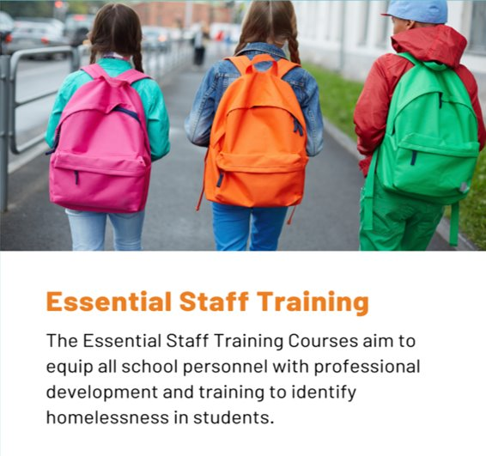
MV Learning
Since the release of the MV Learning Training Courses for the SY21-22:
Over 50% of New Jersey's District Homeless Liaisons have successfully completed the Level 1 and Level 2 Online Credentialing Courses.
Approximately 100 local educational agencies (LEAs) have successfully completed the Essential Staff Training Courses.

Slide 23
Use of Funds
Grant funds may be used for the 16 activities authorized under Section 723(d) of the McKinney-Vento Homeless Assistance Act. For more information, LEAs should reference the list of authorized activities in section 723(d) of the EHCY statute, 42 U.S.C. § 11433(d).
https://oese.ed.gov/files/2021/04/ARP-Homeless-DCL-4.23.pdf

Slide 24
Priority Use of Funds
Increase outreach and identification;
Enhance communication options with students and families;
Partner with Community-Based Organizations or hire “systems navigators” to help families and youths access wrap-around services;
Help meet rising mental health needs;
Increase counseling and social services; and
Provide more transportation options.
Overall, costs must be “reasonable and necessary” and align with the purpose of, and other requirements in, the EHCY statute.
LEAs also should consider the extraordinary impact of the pandemic on students experiencing homelessness when making decisions about how to use funds.

Slide 25
ARP-HCY Implementation (1 of 2)
Bergen County LGBTQ+ Alliance - will provide services to homeless youth identifying as LGBTQ. Services will include mental health supports, addiction services, emergency assistance and an outreach advocate to identify and re-engage homeless youth.
Family Support Organization - will provide funds to bridge gaps for families in temporary lodging and provide financial literacy classes as part of a prevention plan agreement.

Slide 26
ARP-HCY Implementation (2 of 2)
Hosting quarterly resource fairs in each county
Provide promotional options for outreach and awareness around McKinney Vento to include paid ads on social media to help spread awareness about rights of MKV students and families.
Expand relationship with the local Head Start Programs to ensure that MV eligible preschool-aged children receive school readiness skills.
Coordinate with the local Camcare Health Services to ensure that preschool-aged children receive preventative care, annual check-ups, and immunizations and health screenings.

Slide 27
Thank You! New Jersey McKinney-Vento Education for Homeless Children and Youth Program
https://nj.gov/education/homeless/
E-mail
McKinney.Vento@doe.nj.gov
Follow Us!
Facebook: @njdeptofed
Twitter: @NewJerseyDOE
Instagram: @NewJerseyDoe

Slide 28
ESEA Stakeholder Engagement
Ms. Andrea Sunderville, Title I, Part A Coordinator Office of Supplemental Educational Programs

Slide 29
ESEA Citations
Title I, Part A – Section 1112(a)(1)(A) and 1112(b)(7-10)
Title I, Part C – Education of Migratory Children: Section 1304(c)
Title I, Part D – Neglected and Delinquent: Section 1423
Title II, Part A – Section 2102(b)(3)(A) and 2102(b)(2)(D)
Title III, Part A – Section 3116(b)(4)(C)
Title IV, Part A – Section 4106(c)(1)(2)
Title IV, Part B – 21st Century Community Learning Centers: Section 4204(b)
McKinney-Vento Homeless Assistance Act

Slide 30
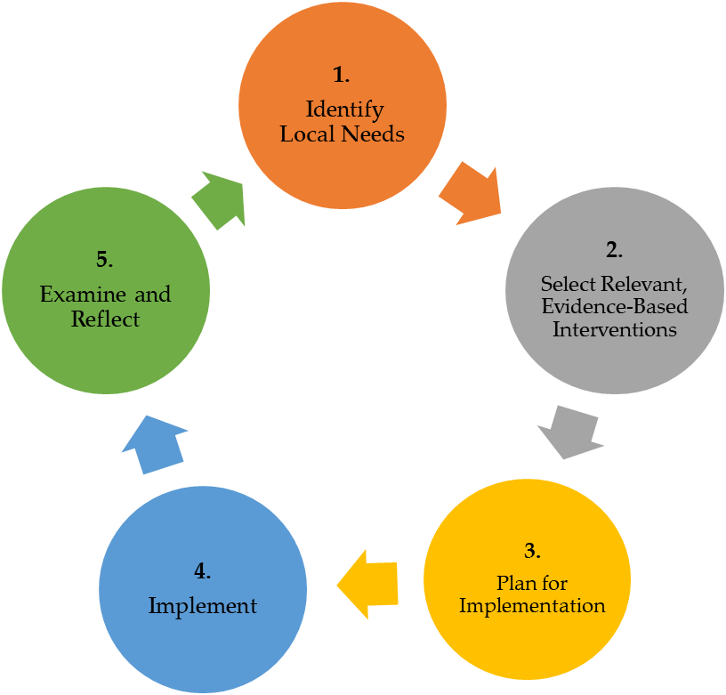
Needs Assessment and Continuous Improvement Cycle
Considerations:
Based on analysis of data and the experiences of those involved, was the intervention successful and should the intervention continue as is, be modified, or be abandoned?
How can experience with the intervention inform future decision making?
Considerations:
What evidence do you have of the need? Is there any data?
What tools, programs or processes are in place that you could build upon to meet the need?
Considerations:
Local capacity, cost, and sustainability
Impact (focus on interventions with highest impact in your setting)
Considerations:
Are implementation timelines being followed? Do they need to be adjusted?
What are barriers (anticipated and unforeseen) to successful implementation? How can these be addressed?
Considerations:
What are the measurable goals associated with the intervention?
How will implementation and performance be monitored?
Source: USED State Support Network. (2018). Needs assessment guidebook: Supporting the development of district and school needs assessments. Washington, DC: American Institutes for Research. Retrieved from https://oese.ed.gov/files/2020/10/needsassessmentguidebook-508_003.pdf

Slide 31
Stakeholder – Basic Definition
An individual or group with a vested interest in the success and welfare of a district or school (organization) in fulfilling its vision and mission, delivering intended results, and maintaining the viability of programs, services, and student outcomes over time.
Meaningful Local Engagement Under ESSA: A Handbook for LEA and School Leaders, Council of Chief State School Officers (CCSSO)

Slide 32
Engagement – Basic Definition
A systematic process of communicating to, learning from, and partnering with individuals and/or groups (stakeholders) to effectively plan and improve an organization (district/school) through the development and implementation of local (strategic) plans for improving outcomes for students.
Meaningful Local Engagement Under ESSA: A Handbook for LEA and School Leaders, Council of Chief State School Officers (CCSSO)

Slide 33
Stakeholder Engagement – A Definition
Meaningful and Ongoing Consultation and Collaboration:
Includes a diverse, representative group of stakeholders;
Starts at the beginning of the process, when initial planning is getting started;
Is transparent and intentional;
Makes time and space for learning and discussion
Takes place at multiple points during the design, development, and implementation of a plan; and
Provides timely feedback and continuous enhancement of evidence-based interventions and strategies to improve student outcomes..

Slide 34
Types of Stakeholders
Internal Stakeholders –
Work within school system
Oversee programs and services
Implement programs and services
External Stakeholders –
Work outside the day-to-day work of school system
Strong, vested interest in school and student outcomes
Do not directly determine what goes into producing school and student outcomes

Slide 35
Stakeholders
District and School – not just the particular people children, parents, or visitors see, but everyone in the ‘system’
Administrators, principals, teachers, board members, counselors, paraprofessionals, psychologists, social workers, custodians, bus drivers, administrative professionals, school resource officers, students, etc.
Parents and Families – first and original teachers, multiple generation families, relatives as guardians
Community Members/Groups – businesses, medical professionals, community, civic, and religious organizations, early childhood providers, government officials and agencies, institutions of higher education, philanthropic entities (funders), professional associations, nonprofit organizations, police, firefighters, etc.

Slide 36
Key Steps to Meaningful Engagement
Clarify goals
Identify Stakeholders
Use multiple ways for engagement
Keep information and materials simple and brief
Communicate early and often
Keep entire team informed
Ask for input before decisions are made and USE IT
Turn these new connections into long-term relationships
Sustained connection well beyond just communication

Slide 37
Engagement by…….
Understanding and Communicating –
Vision, mission, and goals of the educational system
Importance of partnering to find solutions and make decisions
Role clarity (how to participate and who the stakeholder represents)
Practices, policies, and procedures (the work) and how it is tied to student outcomes
Available resources (time, capacity building, professional development, technology, location)
Established feedback loops (ongoing evaluation, deeper understanding of opportunities and barriers)

Slide 38
How to Strengthen Stakeholder Engagement
Online engagement or responses –
Web, written, or email-based feedback/discussion forums; virtual platforms, webinars, recorded videos
Surveys (in-person, online, or by telephone)
Focus groups and small group meetings
Public meetings or multi-stakeholder forums to disseminate information, share data, or gather input and feedback
Advisory panels
Cross-sector partnerships, voluntary initiatives, and joint projects
Connection with media outlets (social media for input and networking opportunities)
Designate a parent/family/community liaison to support coordinated engagement efforts among parents, students, and the community

Slide 39
Stakeholder Engagement: Questions to Consider
When should outreach begin so a representative group of stakeholders can be engaged?
How will you provide feedback to stakeholders on how their input was integrated in your decision-making?
Which stakeholders will be most responsive to brief versus in-depth discussions?
Who can help to ensure your materials are clear, concise, and appropriate for your stakeholders?
What is the best way to provide stakeholders with an ongoing source of reliable information?
What existing tools can you use? What new ones can you create?

Slide 40
Stakeholder Engagement: Questions to Consider Cont'd.
Who will serve as a point of contact with all stakeholder groups?
What additional capacity and/or training is needed to engage stakeholders in a meaningful, timely, and ongoing manner?
What other opportunities exist or are on the horizon that could be informed by stakeholder engagement?
How else can stakeholders be kept engaged and informed once planning and implementation is complete?
How will you know if this engagement was successful (evaluation, monitoring)?

Slide 41
Benefits of Stakeholder Engagement
Creates more deliberate planning
Decisions are made in an inclusive and transparent manner
Fosters connections, trust, confidence, and buy-in for key initiatives
Develops long-lasting partnerships
Mitigates potential risks and conflicts (resistance to change)
Builds local capacity to support and sustain goals (student outcomes)

Slide 42
Thank You!
New Jersey Department of Education Every Student Succeeds Act (ESSA)
New Jersey Department of Education Local Stakeholder Engagement Guidance
Email:
Title I, Part A - titleone@doe.nj.gov
Follow Us!
Facebook: @njdeptofed
Twitter: @NewJerseyDOE
Instagram:@NewJerseyDoe

Slide 43
ARP-HCY I / M.O.E.S.C Mr. Alan Ferraro, Region III Director McKinney-Vento Homeless Services &Training

Slide 44
ARP-HCY I / M.O.E.S.C. ~ Region III (1 of 7)
McKinney Vento History
Stewart B. McKinney Act 1987
Every Student Succeeds Act 2015
McKinney Vento Amendments 2016
ARP-HCY I 2022
Networking to Collaboration

Slide 45
ARP-HCY I / M.O.E.S.C. ~ Region III (2 of 7)
Strategic Plan
Monarch Housing Associates
Rutgers University/Bloustein School of Planning and Public Policy
Identification-Homeless Students
School District/Region Data Development

Slide 46
ARP-HCY I / M.O.E.S.C. ~ Region III (3 of 7)
Community Based Organizations
Collaboration Linkages
Existing Agency Service
Social Service
Education
Housing

Slide 47
ARP-HCY I / M.O.E.S.C. ~ Region III (4 of 7)
School District Collaboration Facilitators
Manager-Housing
Coordinated Entry Housing Agency
Navigator-Social Service
Care Management Organization

Slide 48
ARP-HCY I / M.O.E.S.C. ~ Region III (5 of 7)
School District Homeless Liaison-Family Housing Assistance
Manager – Housing
Coordinated Entry Housing Agency
State/County Housing Agencies
Private Housing Services

Slide 49
ARP-HCY I / M.O.E.S.C. ~ Region III (6 of 7)
School District Homeless Liaison-Social Service Assistance
Navigator –Social Services
New Jersey Integrated Care for Kinds
Medicaid Service
Medical Service
Faith Based Intervention
Public/Private Social Service

Slide 50
ARP-HCY I / M.O.E.S.C. ~ Region III (7 of 7)
Additional ARP–HCY I Additional Services
Strategic Plan –Bid Agency
Inter-faith Hospitality Network
Faith Based Intervention
Family Promise
180 Turning Lives Around
Dottie’s House
Harbor House
HomeFront
Women Aware
Emergent Transportation to Agency/School of Origin
Emergent – Short Term Homeless Transportation

Slide 51
Hamilton Township School Mr. Anthony Scotto, Director ESEA Programs

Slide 52
Thank You! New Jersey Department of Education Website
nj.gov/education
Questions may be submitted to:
ESSER@doe.nj.gov
Registration now open for the May 18, 2022, ARP ESSER Round Table
Follow Us!
Facebook: @njdeptofed
Twitter: @NewJerseyDOE
Instagram: @NewJerseyDoe

